Slide 1
Formal Methods in Software Engineering

Slide 2
Propositional Calculus
Proposition is a statement that can either be TRUE or FALSE.
A statement is a declarative sentence that
is either true or false but not both. A statement is also referred to as a proposition.
EXAMPLES: 1.Grass is green. 2.4 + 2 = 6
3.4 + 2 = 7
4.There are four fingers in a hand. are propositions
Not Propositions
Close the door.
x is greater than 2.
He is very rich are not propositions.

Slide 3
Implication
P | Q | P ⇒ Q
T | T | T
T | F | F
F | T | T
F | F | T
If p and q are statement variables, the conditional of q by p is “If p then q” or “p implies q” and is denoted p → q. It is false when p is true and q is false; otherwise it is true. The arrow "→ " is the conditional operator, and in p → q the statement p is called the hypothesis (or antecedent) and q is called the conclusion (or consequent).

Slide 4
Bi-conditional – if and only if
P | Q | P ⇔ Q
T | T | T
T | F | F
F | F | T
F | T | F
P ⇔ Q means P ⇒ Q ∧ Q ⇒ P
If p and q are statement variables, the biconditional of p and q is “p if, and only if, q” and is denoted p↔q. if and only if abbreviated iff. The double headed arrow " ↔" is the biconditional operator.

Slide 5
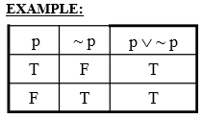
A compound proposition that is always true, irrespective of the truth values of the comprising propositions, is called a tautology.
p ∨ ¬ p
A tautology is a statement form that is always true regardless of the truth values of the statement variables. A tautology is represented by the symbol “T”.
Tautology in Song
“I want to live while I am alive”
“There's nothing you can do that can't be done. There's nothing you can sing that can't be sung”
“Only the lucky ones... get lucky”
“Shout it out loud!”

Slide 6
The propositions p and q are called logically equivalent if p ⇔ q is tautology.
It is written as ,
p ≡ q
For example: ¬ (p ∨ q) ≡ ¬ p ∧ ¬ q

Slide 7
Some useful equivalences
p or true ≡ true
p or false ≡ p

Slide 8
Some useful equivalences
p or true ≡ true
p or false ≡ p
p and true ≡ p
p and false ≡ false

Slide 9
Some useful equivalences
p or true ≡ true
p or false ≡ p
p and true ≡ p
p and false ≡ false
true ⇒ p ≡ p | false ⇒ p ≡ true
p ⇒ true ≡ true | p ⇒ false ≡ not p

Slide 10
Some useful equivalences
p or true ≡ true
p or false ≡ p
p and true ≡ p
p and false ≡ false
true ⇒ p ≡ p | false ⇒ p ≡ true
p ⇒ true ≡ true | p ⇒ false ≡ not p
p or p ≡ p
p and p ≡ p

Slide 11
Some useful equivalences
p or true ≡ true
p or false ≡ p
p and true ≡ p
p and false ≡ false
true ⇒ p ≡ p | false ⇒ p ≡ true
p ⇒ true ≡ true | p ⇒ false ≡ not p
p or p ≡ p
p and p ≡ p
not not p ≡ p

Slide 12
Some useful equivalences
p or true ≡ true
p or false ≡ p
p and true ≡ p
p and false ≡ false
true ⇒ p ≡ p | false ⇒ p ≡ true
p ⇒ true ≡ true | p ⇒ false ≡ not p
p or p ≡ p
p and p ≡ p
not not p ≡ p
p or not p ≡ true
p and not p ≡ false

Slide 13
Some useful equivalences
associativity of
∨, ∧, and ⇔
Commutativity of
∨, ∧, and ⇔
distributivity of
and over or
or over and
or over ⇒
⇒ over and
⇒ over or
⇒ over ⇒
⇒ over ⇔
Demorgan’s law
Implication
if and only if

Slide 14
Logic problem for the day
Someone asks person A, “Are you a knight?” He replies, “If I am a knight then I’ll eat my hat”.
Prove that A has to eat his hat.

Slide 15
A is a knight: A
A eats his hat: H

Slide 16
A is a knight: A
A eats his hat: H
If I am a knight then I’ll eat my hat:
A ⇒ H

Slide 17
We have seen that (X ⇔ S)
Therefore
(A ⇔ A ⇒ H)
Objective is to logically deduce H

Slide 18
Truth Table Columns
A | H | A ⇒ H | A ⇔ (A ⇒ H)

Slide 19
Proof Using Truth Table
A | H | A ⇒ H
T | T | T
F | T | T
T | F | F
F | F | T

Slide 20
Proof Using Truth Table
A | A ⇒ H | A ⇔ (A ⇒ H)
T | T | T
F | T | F
T | F | F
F | T | F

Slide 21
Proof Using Truth Table
A | H | A ⇒ H | A ⇔ (A ⇒ H)
T | T | T | T
F | T | T | F
T | F | F | F
F | F | T | F

Slide 22
Proof using equivalences
A ⇔ (A ⇒ H)
≡ A ⇔ (not A or H)
≡ (A and (not A or H)) or
(not A and not (not A or H))

Slide 23
Proof using equivalences
A and (not A or H)
≡ (A and not A) or (A and H)
≡ false or (A and H)
≡ A and H

Slide 24
Proof using equivalences
not A and not (not A or H)
≡ not A and (A and not H)
≡ (not A and A) and not H
≡ false and not H
≡ false

Slide 25
Proof using equivalences
Hence
A ⇔ (not A or H)
≡ (A and H) or false
≡ A and H

Slide 26
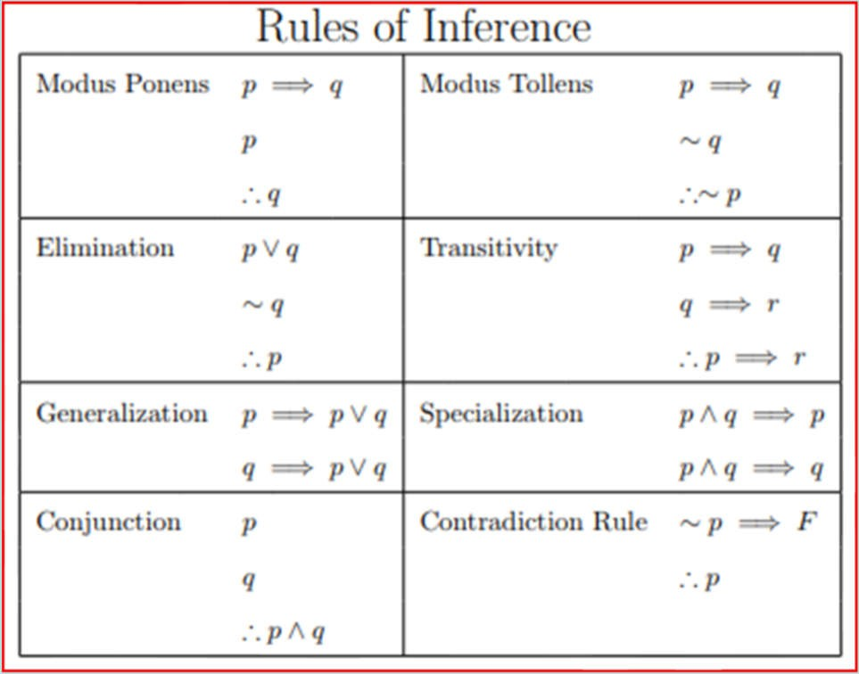
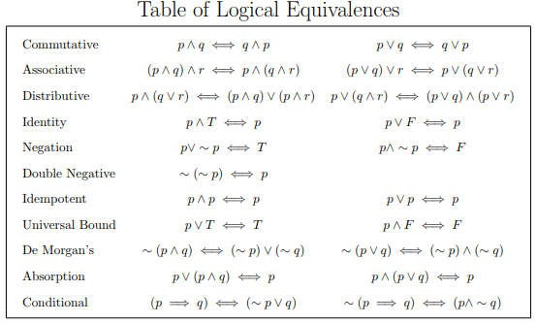
Rules of Inference
& Logical
Equivalences

Slide 27
Rules of Inference and Logical Deduction
Introduction Elimination

Slide 28
Rules of Inference and Logical Deduction
Introduction
p q p and q

Slide 29
Rules of Inference and Logical Deduction
Elimination
p and q p
p and q q
If p and q is true then p is also true, Similarly if p and q is true then q is also true

Slide 30
Rules of Inference and Logical Deduction
Introduction
p
p or q
q
p or q

Slide 31
Rules of Inference and Logical Deduction
Introduction
[p] q
We have q, we can imply p➔q
If q is true the p ➔ q is always true, no matter what the value of p is? If p is false it is going to be true anyway.
If p is true the we already know as q is true then p➔q is also true
p ⇒ q

Slide 32
Rules of Inference and Logical Deduction
Elimination
p p ⇒ q
q
If we are given that p is true and also given that p➔q is alo true that means q has to be true.
Reason: If p is true and q is false then p➔q is not going to be true and hence q is going to be false.
So P is true and p➔q is true then we can conclude q which has to be true

Slide 33
Rules of Inference and Logical Deduction
Elimination
p not p false
_
false p
If p is true the ~p is false. Output is going to be false
If start from false, you can conclude anything i.e. p

Slide 34
Revisiting the Socrates Example
We have the two premises:
“All men are mortal.”
“Socrates is a man.”
And the conclusion:
“Socrates is mortal.”

Slide 35
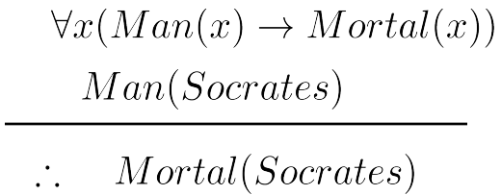
The Argument
We can express the premises (above the line) and the conclusion (below the line) in predicate logic as an argument:

Slide 36
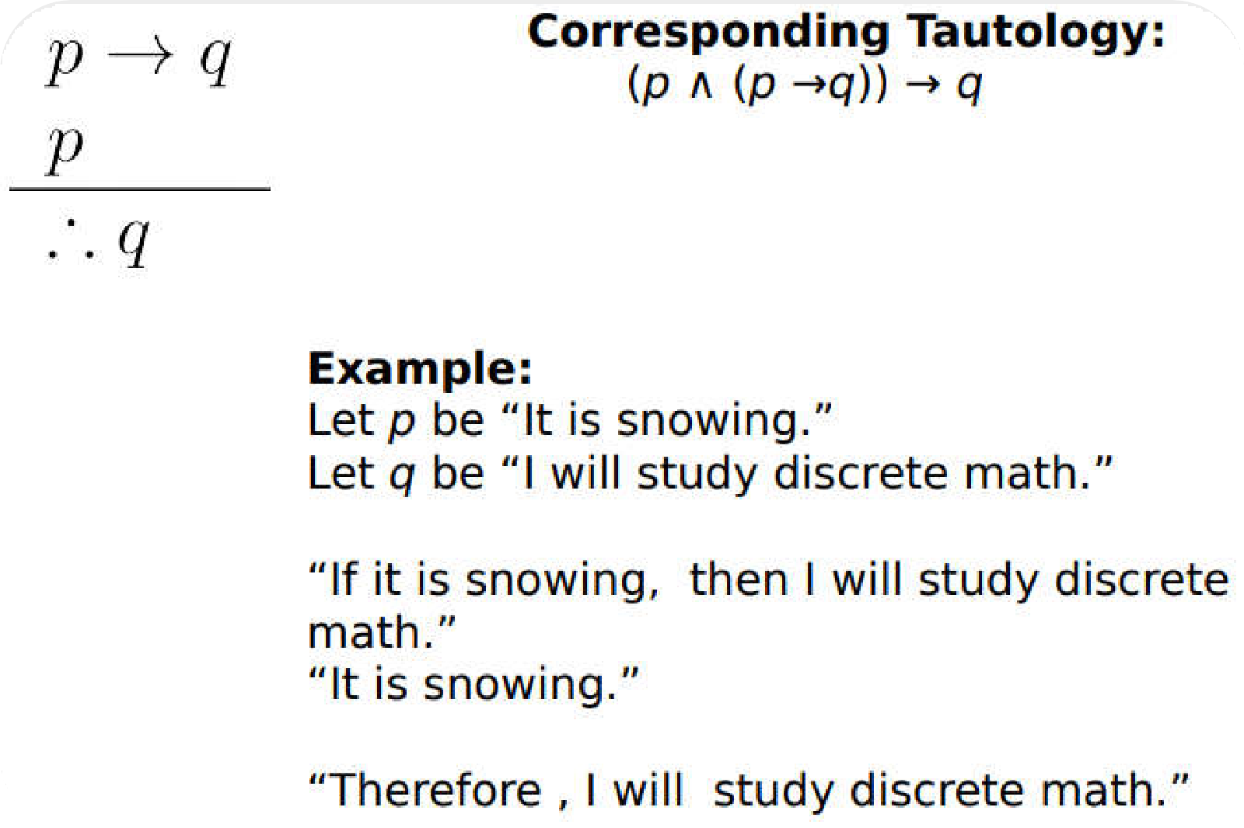
Rules of Inference for Propositional Logic: Modus Ponens

Slide 37
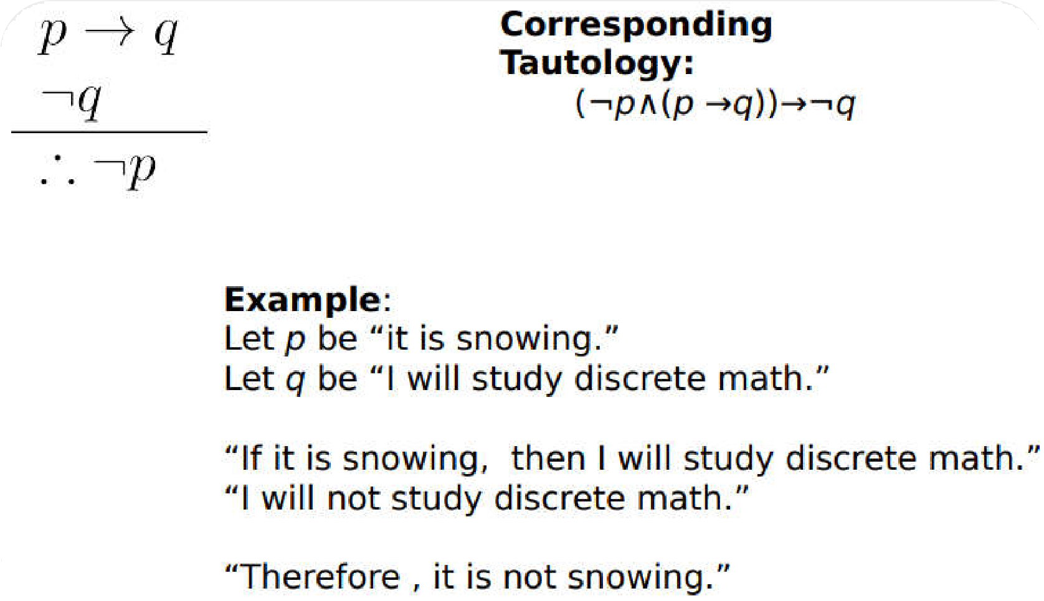

Modus Tollens

Slide 38
Hypothetical Syllogism
Syllogism: An instance of a form of reasoning in which a conclusion is drawn from two given or assumed propositions (premises); a common or middle term is present in the two premises but not in the conclusion, which may be invalid
(e.g.
all dogs are animals
;
all animals have
four
legs therefore all
dogs have four
;
legs
).

Slide 39
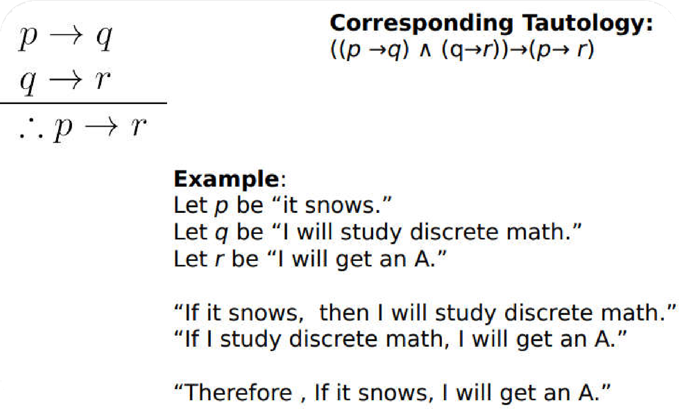
Hypothetical Syllogism

Slide 40
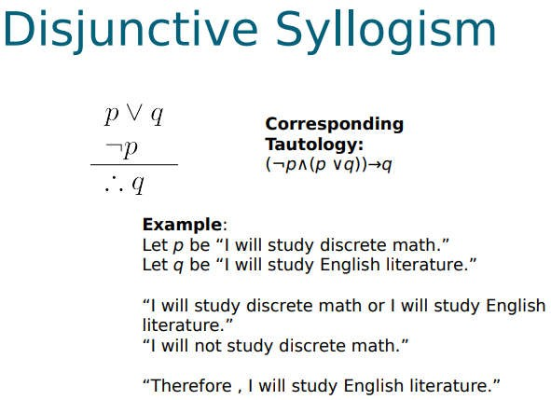
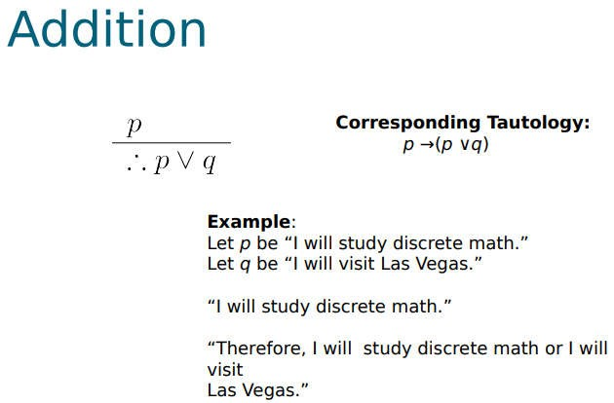
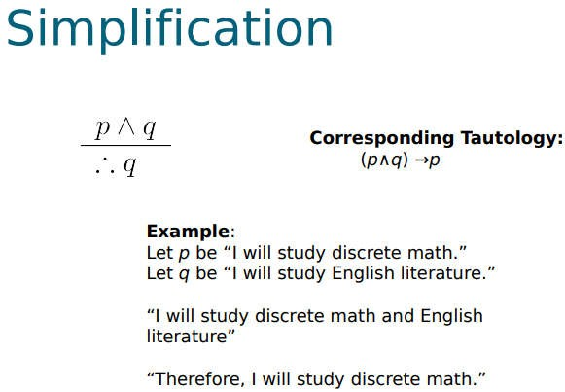
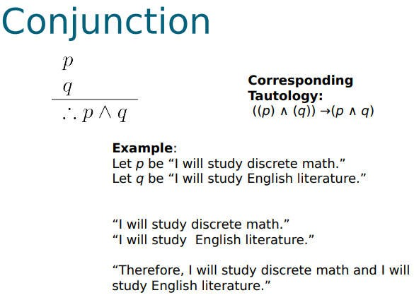

Slide 41
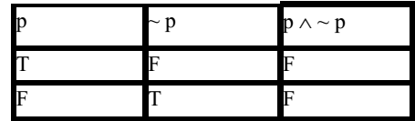
Contradiction
CONTRADICTION: A contradiction is a statement form that is always false regardless of the truth values of the statement variables. A contradiction is represented by the symbol “c”.
So if we have to prove that a given statement form is CONTRADICTION we will make the truth table for the statement form and if in the column of the given statement form all the entries are F ,then we say that statement form is contradiction. EXAMPLE: The statement form p ∧ ~ p is a contradiction.
Since in the last column in the truth table we have F in all the entries so is a contradiction p ∧ ~p ≡c

Slide 42
Zero is even or odd?
even ± even = even
odd ± odd = even
even × integer = even
2 − 2 = 0
−3 + 3 = 0
4 × 0 = 0
A number n is odd if there is an integer k such that n = 2k + 1.
One way to prove that zero is not odd is by contradiction: if 0 = 2k + 1 then k = −1/2, which is not an integer.[

Slide 43
Does the Superman Exist?
If Superman were able and willing to prevent evil, he would do so. If Superman were unable to prevent evil, he would be incapable; if he were unwilling to prevent evil, he would be malevolent. Superman does not prevent evil. If Superman exists, he is neither incapable nor malevolent. Therefore Superman does not exist

Slide 44
Inference and deduction
Superman exists
Superman is willing to prevent evil
Superman is able to prevent evil
Superman is malevolent
Superman is incapable
Superman prevents evil
X W A M I E

Slide 45
Inference and Deduction
Our objective is to prove the proposition:
((W and A) ⇒ E)
and ((not A) ⇒ I)
and ((not W) ⇒ M) and (not E)
and (X ⇒ not (I or M))
⇒ not X

Slide 46
1. Assume
((W and A) ⇒ E)
and ((not A) ⇒ I)
and ((not W) ⇒ M) and (not E)
and (X ⇒ not (I or M))
The objective is now to prove not X

Slide 47
2. Assume X

Slide 48
Assume X
Use Elimination Rules to break No. 1 down into 5 premises
(W and A) ⇒ E
(not A) ⇒ I
(not W) ⇒ M
not E
X ⇒ not (I or M)

Slide 49
Now application of elimination on 2 and 7 derives another simple proposition
2. Assume X
X ⇒ not (I or M)
not (I or M)

Slide 50
Now application of elimination on 2 and 7 derives another simple proposition
2. Assume X
X ⇒ not (I or M)
not (I or M)
Now proving I or M will result in a contradiction

Slide 51
We will now analyze W
Assume not W
M (from 5 and 9)
I or M (from 10 - introduction)

Slide 52
Assume W
Assume A
W and A
E
false
I or M
(12 and 13)
(3 and 14)
(6 and 15)
(16)

Slide 53
Assume not A
I
I or M
I or M
(4 and 18)
(19)
(17 and 20)
(11 and 21)
(contradiction 8 and 22)
(2 and 23)
I or M
false
not X

Slide 54
Logic problem for the day
On the island of knights and knaves, it is rumored that there is gold buried on the island. You ask one of the natives, A, whether there is gold on the island. He makes the following response: “There is gold on this island if and only if I am a knight.”

Slide 55
Logic problem for the day
On the island of knights and knaves, it is rumored that there is gold buried on the island. You ask one of the natives, A, whether there is gold on the island. He makes the following response: “There is gold on this island if and only if I am a knight.”
The problem is as follows:
Can it be determined whether A is a knight or a knave?
Can it be determined whether there is gold on the island?

